Slide 1

Totally Awesome Computing
Python as a General-purpose Object-oriented Programming Language
Chuck Allison
Copyright is held by the author.
OOPSLA’06, October 22-26, 2006, Portland, Oregon, USA.
2006 ACM 06/0010

Slide 2
About Me
Associate Professor of CS
  Utah Valley State College
A veteran C/C++ guy
  Two books
  80+ articles
  Past Senior Editor of C/C++ Users Journal
  Past contributing member of C++ Standards Committee

Slide 3
About You
You’re very bright
  You came to OOPSLA!
Love to code
  Problem-solving mentality
Can stay alert while sitting for extended periods
Dislike annoying slide animations

Slide 4
About Python
Developed around 1990 by Guido van Rossum
  Named after Monty Python
A superb scripting language
Also a general-purpose programming language
  Fully object-oriented
Can use with Java (Jython), C, C++ (Boost.Python), and .NET (IronPython)

Slide 5
Features
Simple syntax
  Very natural and easy to learn
  A small number of rules applied consistently
Incredibly powerful (“Batteries Included”)
  Useful built-in types and data structures
  Huge library that supports…
    Networking
    XML and web applications
    Mathematical computing
    You name it!

Slide 6
Similarities to Other Languages
Interpreted
  Like Ruby, Perl, Lisp (and Java, C#, but no JIT)
Garbage-collected (automatic memory mgt.)
  Like those just mentioned and others
Object-oriented
  More than most languages (everything is an object)
Supports Operator Overloading
  Like C++, C#
Supports Functional Programming

Slide 7
Python on The Web
Visit www.python.org
Can download Python and many related items of interest
Documentation is there
  Also Guido van Rossum’s tutorial
  And the library reference and module index
Python’s [Tutor] mail list: http://mail.python.org/mailman/listinfo/tutor
Free online book: http://diveintopython.org/

Slide 8
Who Uses Python?
Big Corporations:
  NASA
  NYSE
  Industrial Light and Magic
  Google
And…
  Yours Truly
  Hopefully, you!

Slide 9
What is Python Used For?
Education
Web Programming
Test Scripting
Scientific Programming
Game Development
Much more…

Slide 10
Jedi Wisdom
Perl vs. Python (www.netfunny.com/rhf/jokes/99/Nov/perl.html)
YODA: Code! Yes. A programmer’s strength flows from code maintainability. But beware of Perl. Terse syntax… more than one way to do it… default variables. The dark side of code maintainability are they. Easily they flow, quick to join you when code you write. If once you start down the dark path, forever will it dominate your destiny, consume you it will.
LUKE: Is Perl better than Python?
YODA: No… no… no. Quicker, easier, more seductive.
LUKE: But how will I know why Python is better than Perl?
YODA: You will know. When your code you try to read six months from now.

Slide 11
Agenda
The Nickel Tour
Built-in Types and Operations
Statements and Control Structures
Functions
Object-oriented Programming

Slide 12
Nickel Tour
Starting Python
Simple Expressions
Variables and Dynamic Typing
Saving and Running Programs

Slide 13
Starting Python
Several ways:
Startup IDLE (or some other IDE)
Type “python” at the command prompt
Run a Python program
  Click on a .py file, or
  Enter “python <prog>” at command prompt

Slide 14
Prelude to Functions and Testing
Define functions with the def statement
Must indent body
  And all subordinate blocks
    if, while, etc.!
    Introduced by a colon
Test frameworks:
  doctest (matches output in comments)
  pyUnit (Python XUnit framework)
    Will see later after classes are introduced

Slide 15
helloworld.py
''' helloworld.py:
Hello World for Python. Illustrates doctest.
>>> hello()
Hello, world!
'''
def hello():
print "Hello, world!"
import doctest
doctest.testmod()

Slide 16
“Life is Better Without Braces”
No more religious wars on where to put the { and }
:-)

Slide 17
Built-in Types and Operations

Slide 18
Python Built-in Types
Numbers
Sequences
  Linear data structures
Dictionaries & Sets
  No duplicates
Files

Slide 19
Numbers
Integers
  32-bit: from -2,147,483,648 to 2,147,483,647
Long integers
  Unlimited size! (Automatic promotion from int)
Real numbers (decimals)
  Same as double in C
Complex numbers
  2 + 3j

Slide 20
Numeric Operators
C plus 2 more
The usual arithmetic ones:
  +, -, *, /, //, **, %
Bitwise operators:
  |, ^, &, ~, >>, <<
Comparisons:
  <, >, <=, >=, ==, != (also <>)

Slide 21
Division Example
>>>1 / 2
0
>>> 1.5 / 2.5
0.59999999999999998
>>> 1.5 // 2.5
0.0
>>> from __future__ import division
>>> 1 / 2
0.5

Slide 22
Long Integers
Arbitrarily large
  Regular integers convert automatically to long:
>>> x = 12345
>>> type(x)
<type 'int'>
>>> x **= 5
>>> x
286718338524635465625L
>>> type(x)
<type 'long'>
>>> x ** 5
1937659030411463935651167391656422626577614411586152317674869233464019922771432158872187137603759765625L

Slide 23
Sequences
Linear, expandable collections accessed by position
  (0-based)
3 types:
    Strings
    Lists
    Tuples
Note: strings and tuples are immutable

Slide 24
Common Sequence Operations
Functions: len( ), min( ), max( ), zip( ), sum( ) (sum doesn't work on strings)
Comparisons: <, <=, >, >=, ==, !=
Concatenation with +
Replication with *
Membership tests with in
Iteration with for
Slices (subsequences)

Slide 25
Using split( ) and join( )
Example
>>> s = 'a,b,c d,e'
>>> s.split()
['a,b,c', 'd,e']
>>> s.split(',')
['a', 'b', 'c d', 'e']
>>> (s+',,').split(',')
['a', 'b', 'c d', 'e', '', '']
>>> ','.join(['x','y','z'])
'x,y,z'
>>> ''.join(['x','y','z'])
'xyz'

Slide 26
Slices
Extracts an indexed subsequence
Syntax: s[start:endp1]
  For example "hello"[1:3] == "el"
s[p:] extracts from position p to the end
s[:p] extracts from the beginning up to but not including position p (and p items are extracted)

Slide 27
Envisioning Slices
"Help"
+---+---+---+---+
| H | e | l | p |
+---+---+---+---+
0 1 2 3 4 (outside)
-4 -3 -2 -1
The first (0-th) character is s[-len(s)]

Slide 28
Working with Lists
Lists are mutable sequences of values
  Can change them with list methods
Delimited by brackets: [a,b,c]
Can store any mixture of types
Lists store a reference to the objects they logically contain
  It is possible (and common) for different lists to refer to common objects

Slide 29
List Methods
count(x)
index(x)
pop(i = -1)
append(x)
extend(seq)
insert(i,x)
remove(x)
reverse()
sort(f = cmp)
Number of x’s
Where first x is
Removes at position
Appends an element
Appends a sequence
Inserts x at position i
Removes first x
Obvious!
Sorts in place
Notes:
Note that functions can have default arguments.
cmp is built-in function similar to C’s strcmp.

Slide 30
Using +=
x = []
x += (1,2,3)
x
[1, 2, 3]
x += "abc"
x
[1, 2, 3, 'a', 'b', 'c']
x += [4,(5,6),'seven']
x
[1, 2, 3, 'a', 'b', 'c', 4, (5, 6), 'seven']

Slide 31
List Comprehensions
A powerful list-creation facility
Uses special expression syntax in brackets
The result list is returned:
>>> x = [x*x for x in range(1,11)]
>>> x
[1, 4, 9, 16, 25, 36, 49, 64, 81, 100]
>>> [i for i in range(20) if i%2 == 0]
[0, 2, 4, 6, 8, 10, 12, 14, 16, 18]

Slide 32
QuickSort with
List Comprehensions
def qsort(L):
if len(L) <= 1: return L
return qsort([lt for lt in L[1:] if lt < L[0]]) \
+ [L[0]] \
+ qsort([gt for gt in L[1:] if gt >= L[0]])

Slide 33
Working with Tuples
Tuples are like lists, but they are immutable
Delimited by parentheses: (a,b,c)
Commonly used to return multiple values from a function
Also used for multiple assignment
  Swap idiom (see next slide)

Slide 34
Multiple Assignment with Tuples
You can place tuples on either side of an assignment
  Parentheses are optional in this case
The assignments are made component-wise:
>>> x,y = 1,2
>>> x
1
>>> y
2
>>> x,y = y,x
>>> x
2
>>> y
1

Slide 35
Dictionaries
Hash Tables
Associate a key with a value
  Stored as unordered pairs
  Keys must be immutable and unique
Fast lookup by key
  Not position
  Uses index notation

Slide 36
Working with Dictionaries
Delimited by braces: m = {'a' : 1, 'b' : 2}
Access by key with brackets: m['a'] == 1
Add pairs the same way: m['c'] = 3
  Now m == {'a' : 1, 'b' : 2, 'c' : 3}
  This also can update a value: m['a'] = 20
    Now m == {'a' : 20, 'b' : 2, 'c' : 3}

Slide 37
Dictionary Methods
has_key(x) (can also use “in”)
keys( )
values( )
items( ) (returns list of pairs)
copy( ) (shallow copy)
d1.update(d2) (merge 2 dictionaries)
get(key, def = None)
setdefault( ) (= get( ) + create)
Use del to remove items by key

Slide 38
Dictionary Example
>>> phonelist = {}
>>> phonelist['joe'] = '123-4567'
>>> phonelist['bob'] = '890-1234'
>>> keys = phonelist.keys()
>>> keys.sort()
>>> keys.items()
>>> keys.sort(lambda s, t: -cmp(s,t))
>>> keys
['joe', 'bob']
>>> [(name, phonelist[name]) for name in keys]
[('joe', '123-4567'), ('bob', '890-1234')]
>>> phonelist.setdefault('jane', 'unlisted')
'unlisted'
>>> phonelist
{'jane': 'unlisted', 'bob': '890-1234', 'joe': '123-4567'}
Notes:
Note the use of anonymous functions with lambda. Alas, only single expressions can follow arguments in a lambda.

Slide 39
File Methods
open(<fname>, <mode> = ‘r’)
read( ) (whole file into a string)
read(n) (n bytes)
readline( ) (next line)
readlines() (all lines; also xreadlines( ))
write(s)
writelines(L)
close( )

Slide 40
File Example
>>> f = open('test.dat', 'w')
>>> f.write('This is line 1\n')
>>> lines = ['line 2 start', ' line 2 end\n', 'line 3\n']
>>> f.writelines(lines)
>>> f.close()
>>> f = open('test.dat')
>>> for line in f: print line,
This is line 1
line 2 start line 2 end
line 3

Slide 41
Statements and Control Structures

Slide 42
Programs
Python programs are made of modules
  Including one main module (the one you launch Python with)
  Modules may be gathered into packages
Modules are made up of statements
Statements consist of keywords and/or expressions
Program => Modules => Statements

Slide 43
Python Statements
Assignments
Control flow
  if, while, for, break, continue, return, yield
Exceptions
  assert, try, raise
Definitions
  def (functions), class
Namespaces
  import, global
Miscellaneous
  pass, del, print, exec

Slide 44
The if statement
Syntax:
  if <condition>:
  <suite> (= indented group of statements)
  elif <condition>:
  <suite>
  …
  else
  <suite>
Indentation is critical!
  Unless you have a 1-liner

Slide 45
Loops
for <item> in <iterable object>
while <condition>:
<suite>
[else:
<suite>]
  Continues until the condition becomes False
  Tests first before executing the block
  An optional else clause executes if the loops completes

Slide 46
Generators
Defines an iterable object with function syntax
  Returns a “generator”
  Can call next( ) explicitly, or can just iterate over it
Use yield instead of return
Each “call” to the generator starts where the last call left off

Slide 47
Generator Example
def countgen():
"""An infinite count generator""" # A doc string
count = 0
while True:
count += 1
yield count
f = countgen()
f
<generator object at 0x00C3E878>
f.next()
1
f.next()
2
f.next()
3
del f

Slide 48
Generator Expressions
Similar to list comprehensions
Defines generators on-the-fly
For simple generators
  yield is not used
  The iteration is implicit from the generated sequence
Just place the expression in parentheses

Slide 49
Generator Expression Example
nums = (i*i for i in range(5))
nums.next()
0
nums.next()
1
nums.next()
4
nums.next()
9
nums.next()
25
nums = (i*i for i in range(5))
sum(nums)
30
sum(nums)
0

Slide 50
Functions

Slide 51
Topics
Duck Typing
Parameter Lists
Decorators
Namespaces and Name Lookup (Scope)

Slide 52
A Fibonacci Function
#Returns the nth Fibonacci number
def fibonacci(n):
curr,prev = 0,1
for i in range(n):
curr,prev = prev+curr,curr
return curr
# Note: We didn't "declare" n to be int

Slide 53
Parametric Polymorphism
If a function can take different types of parameters, it is called “polymorphic”
  In particular, it exhibits “parametric polymorphism”
This is also called “duck typing”
  “If it looks like a duck, quacks like a duck,…”
  aka “Structural Conformance”
C++ uses function templates

Slide 54
Illustrating Duck Typing
Python’s min( ) function
Can process sequences of any type
  The sequence must contain objects that can be compared compatibly
    For example, not a mixture of numbers and strings
The contained type(s) must just support a less-than operator
See next slide

Slide 55
A min( ) function
def mymin(stuff):
smallest = stuff[0]
for x in stuff[1:]:
if x < smallest: smallest = x
return smallest
print mymin([4,3,2,1])
print mymin(['how','now','brown','cow'])
Output:
1
brown

Slide 56
Passing Parameters
Parameters can have default values
  Must be immutable objects
Parameters can be accessed positionally or by name
Variable-length parameter lists supported
Each argument is assigned to its corresponding parameter
  So the original binding at the call point is undisturbed (like Java; no pass-by-reference)

Slide 57
Parameters as Keywords
Sometimes functions can have many parameters
  Their order can be hard to remember
If you know their names, you can use them explicitly in the call
  And not worry about the order
See next slide

Slide 58
Using Parameters as Keywords
#keyparms.py
def displayStuff(name, address, city, zip, phone):
print 'Name =', name
print 'Address =', address
print 'City =', city
print 'Zip =', zip
print 'Phone =', phone
displayStuff(name='john doe', address='some street',\
city='somewhere', phone='123-4567‘,\
zip='98765')
displayStuff('john doe', 'some street',\
city='somewhere', phone='123-4567',\
zip='98765')

Slide 59
Variable-length Argument Lists
Arguments passed to a function can be collected into a tuple
You just process the tuple on the receiving end
  i.e., inside the called function
Use an asterisk before the parm name
See next slide

Slide 60
Using Variable-length Arg Lists
#print_parms.py
def print_parms(*parms):
print parms
def print_parms2(*parms):
for x in parms:
print x
def mymax(*parms):
return max(parms)
print_parms(1,2,3)
print_parms2(1,2,3)
print mymax(1,2,3)
Output:
(1, 2, 3)
1
2
3
3

Slide 61
Going the Other Way
You can unpack a tuple at the call site
  Just use the asterisk there
  It calls the function as if you had provided comma-separated arguments
  They are unpacked in tuple order
Example:
>>> pair = (2,3)
>>> pow(*pair) # same as pow(2,3)
8

Slide 62
Variable-length Keyword Args
You can have any number of keyword parameters
  Must follow all positional parameters
Pythpn passes a dictionary instead of a tuple
  Use a double-asterisk (**parms)
See next slide

Slide 63
Using **parms
#keyparms2.py
def displayStuff(extra='', **stuff):
print 'Name =', stuff['name']
print 'Address =', stuff['address']
print 'City =', stuff['city']
print 'Zip =', stuff['zip']
print 'Phone =', stuff['phone']
if extra and stuff.has_key(extra):
print stuff[extra]
displayStuff(name='john doe', address='some street',\
city='somewhere', phone='123-4567',\
zip='98765')
displayStuff('state',name='john doe',address='some street',\
city='somewhere', phone='123-4567',\
zip='98765',state='oblivion')

Slide 64
Going the Other Way
You can pass a dictionary at the call site
It is unpacked into individial keyword arguments
See next slide

Slide 65
All About Call Conventions
#hello.py
def hello(name = 'world', greeting = 'hello'):
print '%s, %s!' % (greeting, name)
# Predict the output below:
hello()
hello(name = 'joe')
hello(name = 'joe', greeting = 'get lost')
stuff = ('jane','hello')
hello(*stuff)
stuff = {'name':'cruel world', 'greeting':'goodbye'}
hello(**stuff)

Slide 66
A Very Flexible Function
Accepts any number of args, positional or keyword
# allargs.py
def f(*args, **kwargs):
for arg in args:
print arg
for key in kwargs:
print key, '=', kwargs[key]
f(1,2,t=3,f=4)
# Output:
1
2
t = 3
f = 4

Slide 67
Decorators
Functions that alter the definition of other functions
They act as wrappers
  Your function is passed to them as a parameter
  They replace the original function with a new function that “decorates” the original
They can be chained
See also: @staticmethod, @classmethod

Slide 68
Using a Decorator
def trace(f):
def wrapper(*args1, **args2):
print f.__name__,'with',args1,args2
return f(*args1, **args2)
return wrapper
@trace # Same as “foo = trace(foo)”
def foo(parm): # |
print parm # V
@trace
def bar(parm1, parm2):
print parm1, parm2

Slide 69
Sample Execution
foo(1)
bar(2,3)
foo(parm=4)
bar(5,parm2=6)
# Output:
foo with (1,) {}
1
bar with (2, 3) {}
2 3
foo with () {'parm': 4}
4
bar with (5,) {'parm2': 6}
5 6

Slide 70
Namespaces
Name Lookup Tables
A namespace is created for every:
  Module
    This is the “global” namespace/scope
  Function
    This is a “local” namespace/scope
    There is no “block scope”
  Class
  Class instance (object)

Slide 71
The LEGB Rule
First, the current (“local”) scope’s namespace is searched
  A local name “hides” an identical non-local name
If the name is not found, its enclosing scope’s namespace is searched
  This could be a function or the global (“top-level”) scope
Finally, the built-in namespace is searched
The vars( ) function returns local bindings

Slide 72
Name Lookup Example
"scope.py"
a = 1
n = 1
def f(n):
print 'In f, a =', a, 'and n =', n, vars()
f(10)
print vars()
# Output:
In f, a = 1 and n = 10 {'n': 10}
{'a': 1, 'f': <function f at 0x00AEFE30>, '__builtins__': <module '__builtin__' (built-in)>, 'n': 1, '__name__': '__main__', '__doc__': 'scope.py'}

Slide 73
Modifying Global Variables
Remember that an assignment introduces a new binding
  So you need some special feature to modify a global variable
  Otherwise a new local is created
Note: you can’t directly modify any unqualified, non-local variables other than globals
See next slide

Slide 74
The global Statement
#global.py
a = 2
def f():
global a
print vars() # {}
a = 4
print a # 2
f()
print a # 4

Slide 75
Object-oriented Programming

Slide 76
Topics
Classes
Inheritance
Accessibility and Properties
Static methods vs. Class methods
Bound vs. Unbound methods
Metaclasses
Operator Overloading (if time allows)

Slide 77
Defining Classes
The class statement
Evaluated at runtime
  Like everything else in Python
A class object is created in the current namespace
The class object is a factory:
  You “call” it to create instances
Example starts on next slide

Slide 78
An Animal Class
class Animal(object):
def __init__(self, name):
self.name = name
def whoAmI(self):
return self.name
>>> a = Animal('Rocky Raccoon')
>>> print a.whoAmI()
Rocky Raccoon

Slide 79
Things to Note
All top-level classes should derive from the built-in class object
  New Style vs. Classic classes
Instance methods receive a hidden first parameter pointing to the object
  Called self by convention
Instance attributes are defined dynamically by assignment
  Like any other Python attribute

Slide 80
Special Methods
Names beginning and ending with double underscores are special
__init__( ) is a constructor
  Called to initialize an object at creation
There are many special methods
  e.g., operator overloading: __add__, __call__

Slide 81
Unit Testing with PyUnit
# hellotest.py
import unittest
import hello
class HelloTestCase(unittest.TestCase):
def testHello(self):
assert hello.sayhello() == "Hello, world"
if __name__ == "__main__":
unittest.main()

Slide 82
Specific Animal Classes
Inheritance
class Dog(Animal):
def __init__(self, name):
Animal.__init__(self, name)
def speak(self):
print "Bark!"
class Antelope(Animal):
def __init__(self, name):
Animal.__init__(self, name)
def speak(self):
print "<silent>"

Slide 83
More Observations
Note the explicit calls to the Animal constructor
  It’s not done automatically
    For good reason (lookup algorithm)
  And the object reference (self) is also passed explicitly
The speak method is introduced
  The most derived method is chosen by the lookup algorithm (explained shortly)

Slide 84
Bringing Animals to Life
dog = Dog("Fido")
print dog.whoAmI(),':',
dog.speak()
ant = Antelope("Arnie")
print ant.whoAmI(),':',
ant.speak()
# Output:
Fido : Bark!
Arnie : <silent>

Slide 85
Binding Attributes
You can add attributes to modules, classes, and objects anywhere via assignment:
  Dog.genus = ‘canus’ # class attribute
  dog.scent = ‘musty’ # instance attribute
If you bind a list of variable name strings to a class attribute named __slots__, then only those attributes are allowed in objects of that class

Slide 86
Accessibility
All names are public!
  Can cause name collisions
There is a convention to “reduce” name visibility:
  Start attributes with two underscores
    Do not use two trailing underscores
  Such names are “mangled”
    By prepending ‘_’ plus the class name
    See next two slides

Slide 87
Pseudo-Private Attributes
class Controlled(object):
def __init__ (self, x, y):
self.__x = x
self.__y = y
__z = 'zee'
def display(self):
print 'x:',self.__x,'y:',self.__y, \
'z:',Controlled.__z

Slide 88
Output
c = Controlled('ecks', 'why')
c.display()
print dir(c) # print c’s namespace
c.__x
# Output:
x: ecks y: why z: zee
['_Controlled__x', '_Controlled__y', '_Controlled__z', '__doc__', '__init__', '__module__', 'display']
Traceback (most recent call last):
File "C:\Presentations\OOPSLA\classes.py", line 106, in ?
c.__x
AttributeError: Controlled instance has no attribute '__x'

Slide 89
Properties
A way to transparently use getters and setters through data-like attribute reference
  More efficient than getters if no computation is involved
Use the property special function
  4 parms: getter, setter, deleter, doc string
  Last 3 default to None
  Omitted operations are not available

Slide 90
Properties
class HasProp(object):
def setProp (self, p):
print 'setProp trace'
self.__prop = p
def getProp (self):
print 'getProp trace'
return self.__prop
prop = property(getProp, setProp, None, None)
x = HasProp()
x.prop = 'theProperty'
print x.prop
# Output:
setProp trace
getProp trace
theProperty

Slide 91
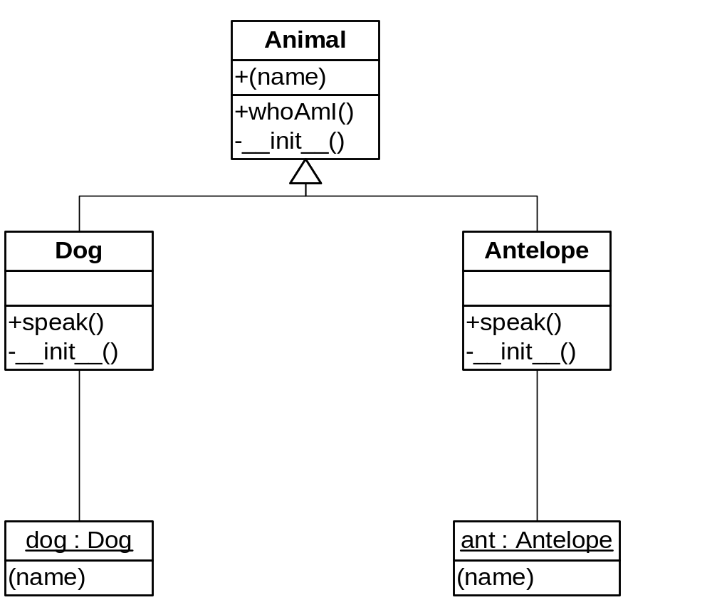
Classes are Objects

Slide 92
Classes are Objects
Objects named Animal, Dog, and Antelope exist
  Created by their respective class statements
They have a namespace (dictionary) mapping their attributes to values
  Animal has __init__ and whoAmI
  But not name!
  name belongs to the object bound to self

Slide 93
Name Lookup Algorithm
When Python sees obj.attr:
  It first looks in the namespace of obj for the attribute name
  If the name is not found, and if obj is an instance of a class:
    Python looks in all superclasses, left-to-right
    The process repeats recursively up the inheritance graph
    So an object’s class and superclasses are an “enclosing scope” for qualified names

Slide 94
Multiple Inheritance
class Basselope(Dog, Antelope):
def __init__(self, name):
Animal.__init__(self, name)
# Note the direct reference to Animal.__init__
# Alternatively:
# super(Basselope,self).__init__(name)
bl = Basselope("Rosebud")
print bl.whoAmI(),':',
bl.speak()
# Output:
Rosebud : Bark!

Slide 95
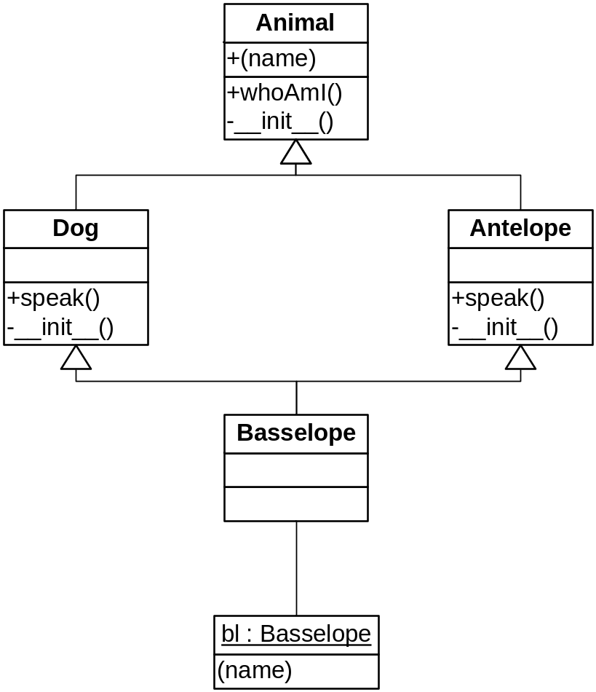
An MI Graph

Slide 96
Static (Class-based) Data
Assignments performed directly inside a class define static (aka class) data attributes
They are added to the namespace of the class
Usually accessed as <class>.<attribute-name>
(See next slide)
Note: In methods, all attributes of a class or object must be accessed via the class or an object name (e.g., self.attr) – unqualified names in methods are considered global!

Slide 97
Static Data
class Foo(object):
data = 'bar'
def __init__(self,data):
self.data = data
def display(self):
print self.data, Foo.data
foo = Foo('baz')
foo.display()
# Output:
baz bar

Slide 98
Static Methods
You can define methods that aren’t connected to an object
Normally accessed as:
  <class-name>.<method-name>
Use the @staticmethod decorator
See next slide

Slide 99
Static Stuff
class StaticStuff(object) :
foo = 1
@staticmethod
def bar () :
return StaticStuff.foo
x = StaticStuff()
print x.foo
print StaticStuff.bar()
# Output:
1
1

Slide 100
Class Methods
Do not exist in C++, Java, C#
Like static methods, you usually call them qualified with the class name
Whenever a class method is called, the class object is passed as a hidden first parameter
  Analagous to self
  cls is the conventional name

Slide 101
Class Methods
class Klass(object) :
@classmethod
def cmethod(cls, x):
print cls.__name__, "got", x
Klass.cmethod(1)
k = Klass()
k.cmethod(2)
# Output
Klass got 1
Klass got 2

Slide 102
An Application of Class Methods
Counting objects
  The logic of counting is type-independent
  How can we automatically make a class “countable”?
Need some form of inheritance, but we want a separate counter for each class
  We dynamically add a counter to each class through the class object parameter of a class method
See next slide

Slide 103
Classy Counting
class Shape(object):
__count = 0 # A shared initializer
@classmethod
def __incr(cls):
cls.__count += 1 # Create/update class attribute
@classmethod
def showCount(cls):
print 'Class %s has count: %s' % \
(cls.__name__, cls.__count)
def __init__(self): # A constructor
self.__incr()

Slide 104
Classy Counting
class Point(Shape): pass
class Line(Shape): pass
p1 = Point()
p2 = Point()
p3 = Point()
Point.showCount()
Line.showCount()
x = Line()
Line.showCount()
# Output:
Class Point has count: 3
Class Line has count: 0
Class Line has count: 1

Slide 105
Revisting +=
The expression cls.__count += 1 is the same as:
cls.__count = cls.__count + 1
New class Shape.__count (= 0)
(When cls.__count doesn’t exist)

Slide 106
C++ Version
A Curiously Recurring Template Pattern
template<class T> class Counted {
static int count;
public:
Counted() { ++count; }
Counted(const Counted<T>&) { ++count; }
~Counted() { --count; }
static int getCount() { return count; }
};
template<class T> int Counted<T>::count = 0;
class CountedClass : public Counted<CountedClass> {};
class CountedClass2 : public Counted<CountedClass2> {};

Slide 107
Methods Are Objects
A method can be bound to an arbitrary variable
Two flavors:
  Unbound method (self is an open variable)
  Bound method (self object is fixed)
    Like delegates in C# and D
    A “closure” for objects; interchangeable with functions
Handy for callbacks

Slide 108
Unbound Methods
muffy = Dog('Muffy')
op = Dog.whoAmI
print op
print op(muffy) # same as muffy.whoAmI()
# Output:
<unbound method Dog.whoAmI>
Muffy

Slide 109
Another Example
def eat(self, food):
print self.whoAmI(),'eating',food
Dog.eat = eat # Add new method to Dog!
dogs = [muffy, sheba]
food = ['melon', 'bones']
for i in range(2):
eat(dogs[i], food[i])
# Output:
Muffy eating melon
Sheba eating bones

Slide 110
Pairing Objects and Arguments
pairs = zip(dogs, food)
print pairs
for pair in pairs:
eat(*pair)
# Output:
[(<__main__.Dog object at 0x00A03090>, 'melon'), (<__main__.Dog object at 0x00A030D0>, 'bones')]
Muffy eating melon
Sheba eating bones

Slide 111
Bound Instance Methods
sheba = Dog('Sheba')
op = sheba.whoAmI
print op
print op() # same as sheba.whoAmI()
map(muffy.eat, food)
# Output:
<bound method Dog.whoAmI of <__main__.Dog object at 0x009FF130>>
Sheba
Muffy eating melon
Muffy eating bones

Slide 112
Bound Class Methods
# Class Methods are Bound Methods
# (Bound to the class, of course)
m = Line.showCount
print m
m()
# Output:
<bound method type.showCount of <class '__main__.Line'>>
Class Line has count: 1

Slide 113
Metaclasses
All objects have a type
The type of a class object is its metaclass
The standard metaclass for all built-in types and class types is the metaclass type
  You can provide your own
The class statement calls the metaclass to generate a new class object

Slide 114
The type Metaclass
>>> class C(object) : pass
>>> c = C()
>>> type(c)
<class '__main__.C'>
>>> type(C)
<type 'type'>
>>> type(1)
<type 'int'>
>>> type(int)
<type 'type'>
>>> type(type)
<type 'type'>

Slide 115
A Custom Metaclass
class MyMetaClass(type): # derive from type
def __str__(cls): return 'Class ' + cls.__name__
class C(object):
__metaclass__ = MyMetaClass
x = C()
print type(x)
# Output:
Class C

Slide 116
Adding Getters Automatically
class Getters(type):
def __new__(cls, name, bases, d):
for var in d.get('__slots__'):
def getter(self, var=var):
return getattr(self, var)
d['get' + var] = getter
return type.__new__(cls, name, bases, d)
class G(object):
def __init__(self, f, b):
self.foo = f
self.bar = b
__metaclass__ = Getters
__slots__ = ['foo', 'bar']
g = G(1,2)
print g.getfoo(), g.getbar() # 1 2

Slide 117
Operator Overloading

Slide 118
Operator Functions
All operators have associated functions
  e.g., ‘+’ corresponds to __add__
Defining these as instance methods overloads the corresponding operator
Others: __or__, __str__, __call__, __getattr__, __setattr__, __getitem__, __setitem__, __len__, __cmp__, __lt__, __eq__, __iter__, __contains__, …

Slide 119
Numeric Operators
class Number(object):
def __init__(self, num):
float(num) # correctness test
self.__num = num
def __add__(self, num):
if (isinstance(num, Number)):
return Number(self.__num + num.__num)
return Number(self.__num + float(num))
def __str__(self):
return '%g' % self.__num
def __neg__(self):
return Number(-self.__num)
__radd__ = __add__

Slide 120
Sample Execution
x = Number(1.2)
y = Number(3.4)
print x,y,-x
print x + y
print x + 2
print 2 + x
# Output:
1.2 3.4 -1.2
4.6
3.2
3.2

Slide 121
Indexing
The method __getitem__(self, i) is called when fetching self[i]
Likewise, __setitem__(self, i, x) processes self[i] = x
See next two slides
Can also overload __getslice__ and __setslice__

Slide 122
Indexing Example
class Stuff(object):
def __init__(self):
self.__data = []
def add(self, x):
self.__data.append(x)
def __getitem__(self, i):
return self.__data[i]
def __setitem__(self, i, x):
self.__data[i] = x
def display(self):
for item in self.__data:
print item,
print
def __len__(self):
return len(self.__data)

Slide 123
Indexing Example
s = Stuff()
s.add(2)
s.add('three')
s.add(4.0)
s.display()
for i in range(len(s)):
print s[i],
print
s[1] = 'one'
s.display()
# Output:
2 three 4.0
2 three 4.0
2 one 4.0

Slide 124
Iteration
You can define your own iterators
  They can be used for loops and in other iterable contexts
  Loops call iter( ) to get an iterator
The iter( ) built-in will in turn call your __iter__, or __getitem__ (in that order)
  Iteration is automatic if you define __getitem__!

Slide 125
Iteration via __getitem__
for x in s: # s from 2 slides ago (Stuff)
print x,
print
print 'one' in s
print map(None, s)
print list(s)
print tuple(s)
# Output:
2 one 4.0
True
[2, 'one', 4.0]
[2, 'one', 4.0]
(2, 'one', 4.0)

Slide 126
Using __iter__
Better for one-pass traversal than __getitem__
  You must implement a next method and maintain state
  Faster than __getitem__, since state is maintained across calls
See next slides

Slide 127
Using __iter__ and next
class MoreStuff(object):
def __init__(self):
self.__data = []
def add(self, x):
self.__data.append(x)
def __iter__(self):
self.__pos = 0
return self

Slide 128
Using __iter__ and next
def next(self):
if self.__pos == len(self.__data):
raise StopIteration
val = self.__data[self.__pos]
self.__pos += 1
return val
def display(self):
for item in self.__data:
print item,
print

Slide 129
Sample Execution
s = MoreStuff()
s.add(2)
s.add('three')
s.add(4.0)
s.display()
for x in s:
print x,
print
# Output:
2 three 4.0
2 three 4.0

Slide 130
Summary
Python is easy to learn
  Clean syntax
  Orthogonal feature set
Python is easy to use
Python is “fast enough”
Python is fully object-oriented

Slide 131
Python is Better
A Python Community “Mantra”
Beautiful is better than ugly.
Explicit is better than implicit.
Simple is better than complex.
Complex is better than complicated.
Flat is better than nested.
Python is better.

Slide 132
Appendix
Exercises

Slide 133
Homework
Strings and Slices
Assign the string "how now brown cow" to a variable
Compute the length of the string
Extract the word "how"
Extract the word "cow"
Extract the word "brown"
Extract all characters up through position 6 (7 letters)
Extract all characters from position 7 to the end
Find all positions of the substring "ow" (use .find( ))
Prepend the string "Well, ", overwriting the variable
Append a question mark (overwriting again)
Compute the new length

Slide 134
Homework
Lists and Files
Write a program that reads a text file, and reports the number of text lines in the file, the length of the longest line, the length of the shortest line, and then prints the lines out in the order they appear in the file.
  (You will need at least one for-loop)

Slide 135
Homework
Lists and Files
Write a program that prints out the number of characters, words, and lines in a text file

Slide 136
Homework
Dictionaries, Lists
Create a small phone book using a dictionary. The key is a name string and the value is a string containing the person’s phone number. Start by creating an empty dictionary: pbook = { }. Then add 3 entries and print the dictionary. Delete one of the entries with del and reprint.
Extra credit: Have the value be a list of strings containing all the person’s phone numbers.
Extra-extra credit. Have the value be a dictionary indicating whether the number is ‘home’, ‘work’, ‘cell’, or whatever.

Slide 137
Exercise
Dictionaries and Files
Read a text file and report how many occurrences of each word there are.

Slide 138
Homework
Dictionaries, Lists and Files
Repeat the word frequency program, but print out the 10 most-frequently occurring words and their count, for example as follows:
the: 101
a: 54
to: 46
string: 46
in: 44
i: 40
and: 38
of: 35
is: 22
for: 22

Slide 139
Exercises
Loops
Print out every other element of a list

Slide 140
Exercises
Parameter Passing Mechanisms
Write a function named superpower that will raise its arguments to powers in succession. For example, the call superpower(2,3,4) computes 2**3**4, and superpower(2,3,4,5) computes 2**3**4**5. Remember that this operator associates right-to-left.

Slide 141
Exercise
Recursion
Write a recursive version of superpower.

Slide 142
Programming Assignment #1
Functions
Write a function named sentence( ) that generates random sentences according to the following grammar:
<S> => the <NP> <VP>
<NP> => <N> | <ADJ> <NP>
<VP> => <V> | <V> <ADV>
<N> => dog | cat | professor | student | rat
<V> => ran | ate | slept | drank
<ADJ> => red | slow | dead
<ADV> => quickly | happily | well
You can just define the words above as lists:
    nounlist = ['dog','cat','professor','student','rat']
    verblist = ['ran','ate','slept','drank']
    adjlist = ['red','slow','dead']
    advlist = ['quickly','happily','well']

Slide 143
Programming Assignment #1
(continued)
As you can by the grammar above, a sentence is just the word “the” followed by a noun-phrase followed by a verb-phrase. A verb-phrase is either a verb or a verb followed by an adverb. A noun-phrase is either a noun or an adjective followed by a noun-phrase(!). Write functions named verbphrase( ) and nounphrase( ) that are called by sentence. Note that nounphrase( ) is recursive. You also will want to use the function randrange( ) in the random module. Here is the output from several successive calls to sentence( ):
The rat slept well.
The slow dead professor drank well.
The dog drank quickly.
The dead dead slow cat slept quickly.

Slide 144
Programming Assignment #2
Functions, Dictionaries
Write a function xref(s) that reads the text file named by s line by line and returns a dictionary with each word in the file as a key paired with a list of the line numbers where the word appears. Use xref to print out a cross-reference listing, which lists each word in alphabetic order, ignoring case. Here is what the output should resemble:
A : [48]
a : [9, 10, 12, 14, 17, 19, 26, 27, 28, 39, 41, 43, 45, 46, 49, 50, 51, 56, 81, 82, 94, 111, 112, 114, 117, 132, 135, 138, 142, 143, 144, 152, 156, 161, 163, 164, 167, 169, 175, 182, 190, 192]
about : [16, 29, 166, 190, 191]
…
yet : [191]
Yet : [181]
You : [45, 169]
you : [19, 41, 44, 81, 90, 112, 113, 134, 135, 143, 148, 170, 174, 179, 188, 190]

